Slide 1
Local Search

Slide 2

Local Search
Neighborhood
Global Minimum
Guess
先随机一个点，向离全局最优解最近的方向走，直到没有比当前更好的邻居，得到局部最优解
碗的例子中用的梯度下降法没问题，因为它不存在局部最优解
需要一个初始解开始迭代，贪心算法不等于local search

Slide 3
Local Search
Neighbor Relation
☞ S ∼ S' : S' is a neighboring solution of S – S'太小很慢 太大错过
☞ N(S): neighborhood of S – the set { S': S ∼ S' }.
SolutionType Gradient_descent()
{ Start from a feasible solution S ∈ FS ;
MinCost = cost(S);
while (1) {
S’ = Search( N(S) ); /* find the best S’ in N(S) */
CurrentCost = cost(S’);
if ( CurrentCost < MinCost ) {
MinCost = CurrentCost; S = S’;
}
else break;
}
return S;
}

Slide 4
Local Search
❖ Vertex cover problem: Given an undirected graph G = (V, E) and an integer K, does G contain a subset V' ⊆ V such that |V'| is (at most) K and every edge in G has a vertex in V' (vertex cover)?
❖ Vertex cover problem: 给定一个无向图 G = (V, E)。找到 V 的一个最小子集 S，使得对于 E 中的每条边 (u, v)，u 或 v 在 S 中
☞ Feasible solution set FS : 所有点V ∈ FS
☞ cost(S) = | S |
☞ S ∼ S': S' can be obtained from S by (adding or)
deleting a single node.
Each vertex cover S has at most |V| neighbors.
☞ Search: Start from S = V; delete a node and check if S' is a vertex cover with a smaller cost.

Slide 5
Local Search
Case 0:
S = ∅
✓
✗
Case 1:
Case 2:
…………

Slide 6

Local Search
Try to improve …
/* 只有加注释的这两行是和Gradient_descent算法不同的 */
☞ The Metropolis人名 Algorithm
SolutionType Metropolis()
{ Define constants k and T;
Start from a feasible solution S ∈ FS ;
MinCost = cost(S);
while (1) {
S’ = Randomly chosen from N(S);
CurrentCost = cost(S’);
if ( CurrentCost < MinCost ) {
MinCost = CurrentCost; S = S’;
}
else {
With a probability , let S = S’;
else break;
}
}
return S;
}
/* 随机选一个 */
/* Random，避免锁死 */
Notes:
注：对于case 1，有一定概率可以跳出local optimum得到正确解。但是对case 0，有可能在加1和减1之间无限震荡……
注：当（温度）T很高时，上坡的概率几乎为1，容易引起底部震荡；当T接近0时，上坡概率几乎为0，接近原始的梯度下降法。

Slide 7
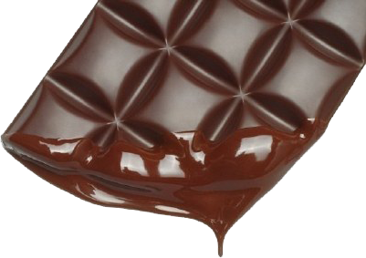
Local Search
☞ Simulated Annealing
温度慢慢降低，获得最优解
Notes:
温度慢慢降低，所以叫退火

Slide 8
Local Search
图 G = (V, E)，边权重为整数 w（正或负）
If w_{e} < 0, where e = (u, v), then u and v want to have the same state;
if w_{e} > 0 then u and v want different states.
± 1
The absolute value |w_{e}| indicates the strength of this requirement.
Output:网络的配置 S –状态的分配s_{u} to each node u
可能不存在能够满足所有边所施加的要求的配置。
7
5
6

Slide 9
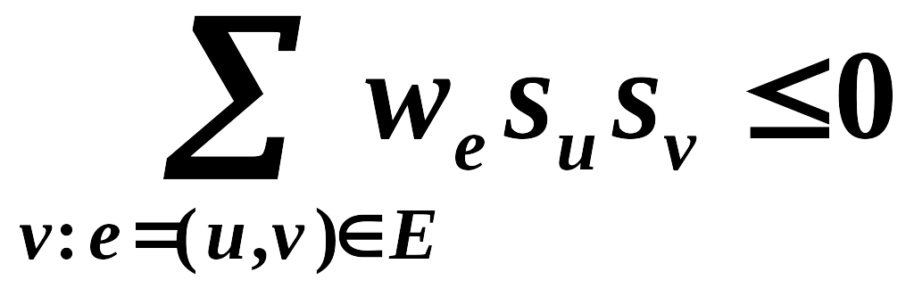
Local Search
〖Definition〗 In a configuration S, edge e = (u, v) is good if w_{e} s_{u} s_{v} < 0 (w_{e} < 0 iff s_{u} = s_{v} ); otherwise, it is bad.
〖Definition〗 In a configuration S, a node u is satisfied if the weight of incident good edges ≥ weight of incident bad edges.
〖Definition〗A configuration is stable if all nodes are satisfied.
Does a Hopfield network always have a stable configuration, and if so, how can we find one?是的
4
-1
-4-1-1+5
✓
-10
-5
-1
-10+5

Slide 10
Local Search
☞ State-flipping Algorithm 不满足的取反
ConfigType State_flipping()
{
Start from an arbitrary configuration S;
while ( ! IsStable(S) ) {
u = GetUnsatisfied(S);
s_{u} = - s_{u};
}
return S;
}
8
-1
下一页ppt证明一定能找到一个可行解
-10
-5
-1

Slide 11
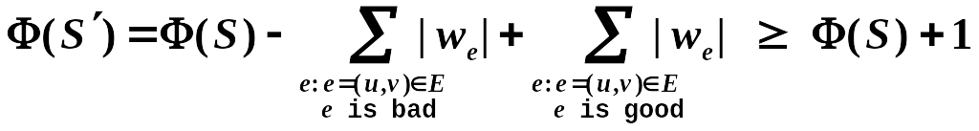
Local Search
Claim: The state-flipping algorithm terminates at a stable configuration after at most W = Σ_{e}|w_{e}| iterations.
Proof:
Consider the measure of progress
Φ(S) = Σ_{e is good} |w_{e}|
  When u flips state (S becomes S’):
  all good edges incident to u become bad
  all bad edges incident to u become good
  all other edges remain the same
反转一次至少增加一次
Clearly 0 ≤ Φ(S) ≤ W
当其从S变成S‘之后，有一个点的颜色翻转了，与之相连的所有good边和bad边的属性都反转，但是其他边属性不变，所以Φ是递增的

Slide 12
Local Search
Related to Local Search
☞ Problem: To maximize Φ.
☞ Feasible solution set FS : configurations
☞ S ∼ S': S' can be obtained from S by flipping a
single state
Claim: Any local maximum in the state-flipping algorithm to maximize Φ is a stable configuration. 状态翻转算法中最大化的任何局部最大值都是稳定的配置。
Is it a polynomial time algorithm?
仍然是一个悬而未决的问题：找到一种算法，可以在 n 和 logW（而不是 n 和 W）的时间多项式中构建稳定状态，或者在仅在 n 上多项式的多个原始算术运算中构建稳定状态，与 W 的值无关。

Slide 13
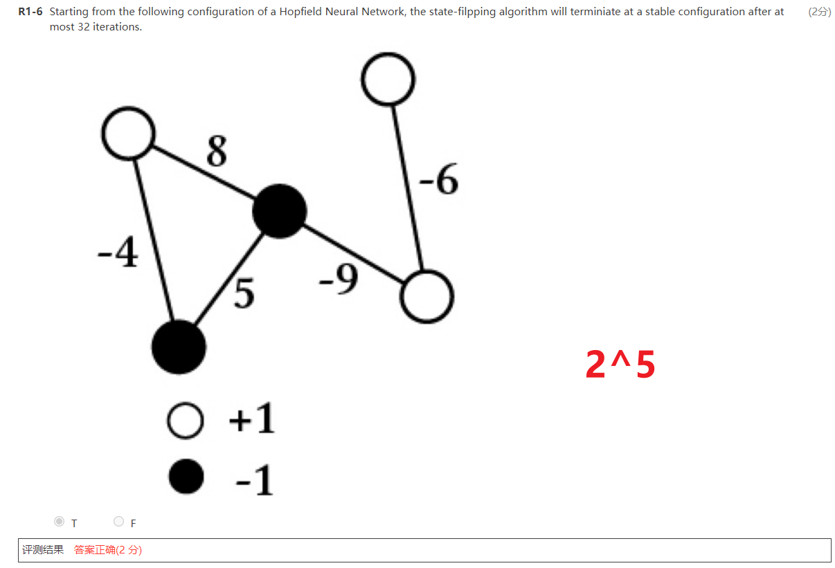

Slide 14
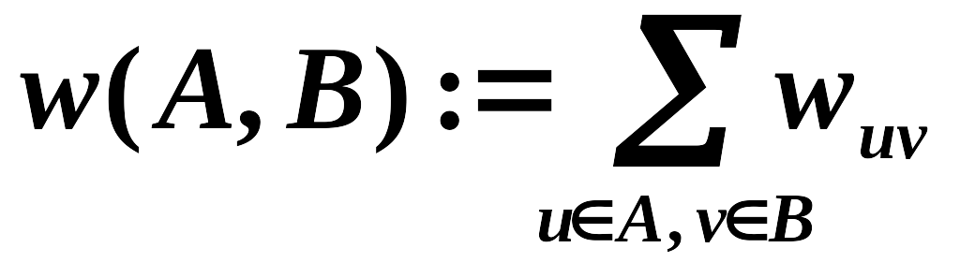
Local Search
最大割问题：给定一个具有正整数边权重的无向图 G = (V, E)，我们找到一个节点分区 (A, B)，使得穿过割点的边的总权重最大化。
Notes:
是Hopfield的特殊情况 (所有边都是正边权)

Slide 15
Local Search
Related to Local Search
☞ Problem: To maximize w(A, B).
Φ(S) = Σ_{e is good} |w_{e}|
☞ Feasible solution set FS : any partition (A, B)
☞ S ∼ S': S' can be obtained from S by moving one
node from A to B, or one from B to A.
 A special case of Hopfield Neural Network – with w_{e} all being positive!
ConfigType State_flipping()
{
Start from an arbitrary configuration S;
while ( ! IsStable(S) ) {
u = GetUnsatisfied(S);
s_{u} = - s_{u};
}
return S;
}

Slide 16
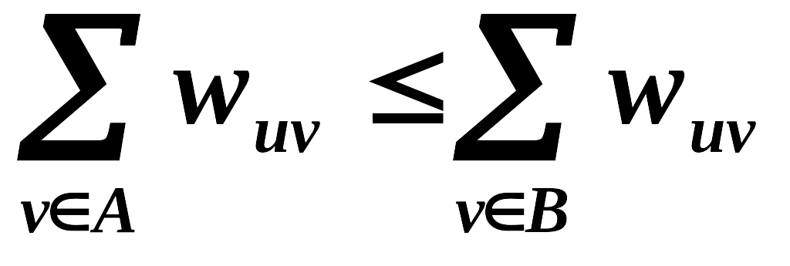
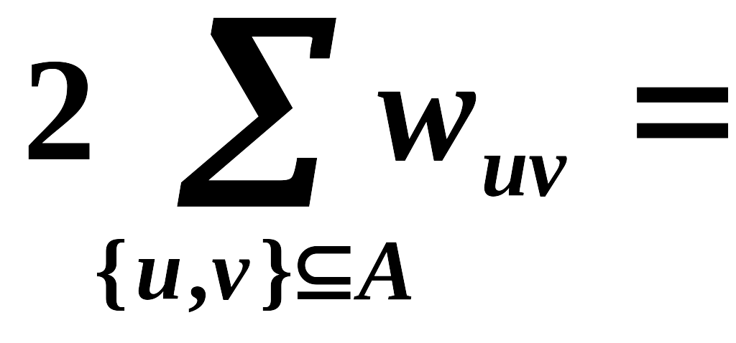
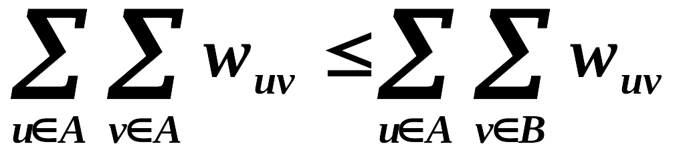
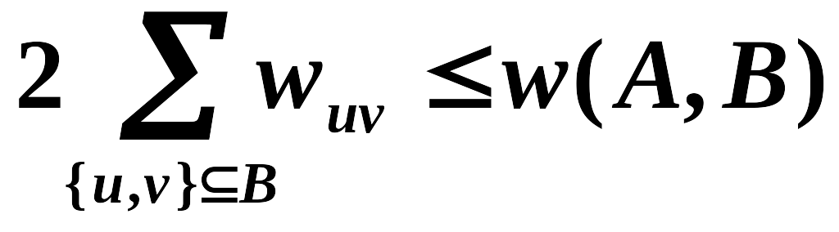
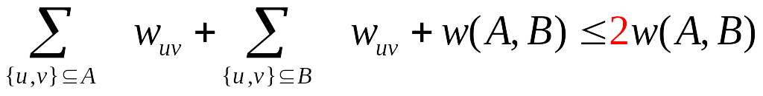
Local Search
Approx-Ratio
Claim: Let (A, B) be a local optimal partition and let (A*, B*) be a global optimal partition. Then w(A, B) ≥ ½ w(A*, B*).
Proof:
Since (A, B) is a local optimal partition, for any u∈A
Summing up for all u∈A
= w(A, B)
w(A*, B*) ≤
ρ is 2

Slide 17
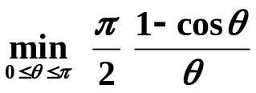
Local Search
Better solution
[Sahni-Gonzales 1976] There exists a 2-approximation algorithm for MAX-CUT.
[Goemans-Williamson 1995] There exists a 1.1382-approximation algorithm for MAX-CUT.
[Håstad 1997] Unless P = NP, no 17/16 approximation algorithm for MAX-CUT.
1.0625

Slide 18
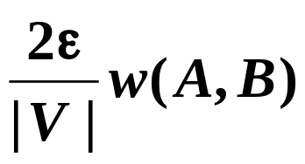
Local Search
May NOT in polynomial time👇硬套公式，yds喜欢搞的
 stop the algorithm when there are no "big enough" improvements.
Big-improvement-flip: Only choose a node which, when flipped, increases the cut value by at least
Claim: Upon termination, the big-improvement-flip algorithm returns a cut (A, B) so that
(2 +ε) w(A, B) ≥ w(A*, B*)
Claim: The big-improvement-flip algorithm terminates after at most O(n/ ε log W) flips.
Notes:
根据时间简单描述证明：
每次flip至少增加(1+epsilon/n)倍，其实是（1+2*epsilon/n)倍
2. n/epsilon次flip之后，总增长至少是2倍。利用(1+1/x)^x >= 2, 如果x>=1
3. 总量不超过W，而cut翻倍的次数不能超过logW

Slide 19
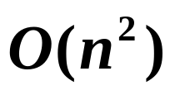
Local Search
Try a better local ?
The neighborhood of a solution should be rich enough that we do not tend to get stuck in bad local optima; but
the neighborhood of a solution should not be too large, since we want to be able to efficiently search the set of neighbors for possible local moves.
Single-flip k-flip
Θ(n^{k}) for searching in neighbors
[Kernighan-Lin 1970] K-L heuristic
Step 1: make 1-flip as good as we can – O(n)
(A₁, B₁) and v₁
Step k: make 1-flip of an unmarked node as good as we can – O(n-k+1)
(A_{k}, B_{k}) and v₁…v_{k}
Step n: (A_{n}, B_{n}) = (B, A)
Neighborhood of (A, B) = { (A₁, B₁), …, (A_{n-1}, B_{n-1}) }
Notes:
K-L的分析还是未解决的。

Slide 20
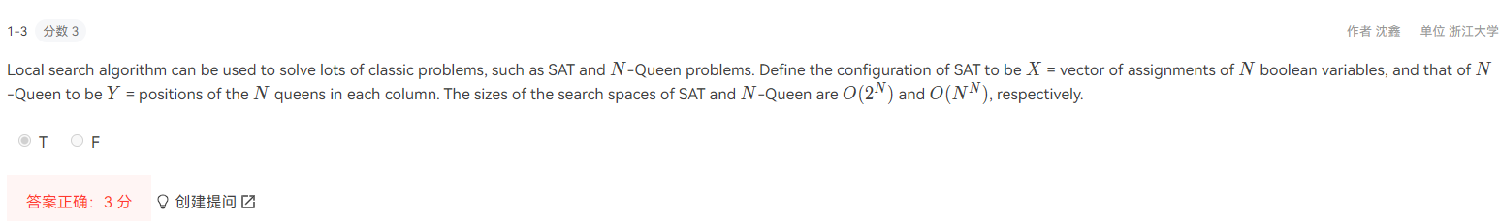
Notes:
N^N其实更准确说的是N!

